Slide 1
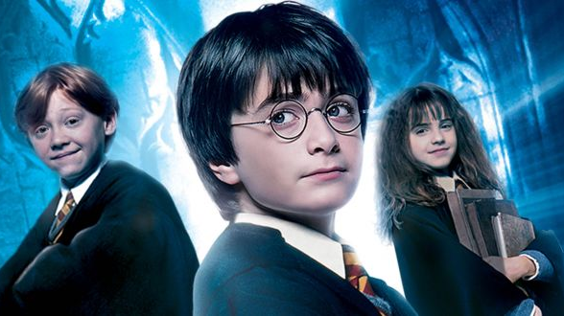
HARRY POTTER and the SORCERER’S STONE
Adrian Edo Martin
Vishakha Krishna
Vidya Vinobha

Slide 2
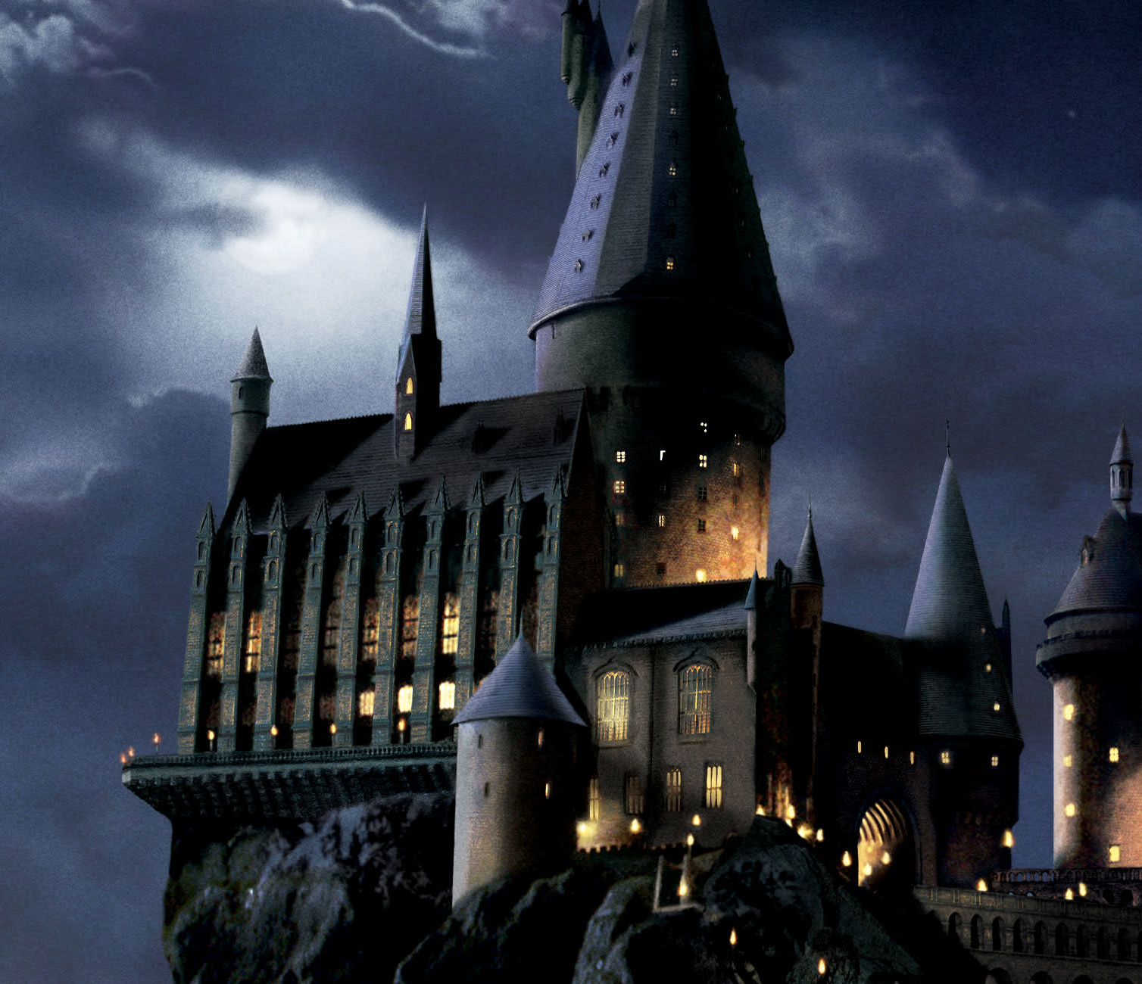
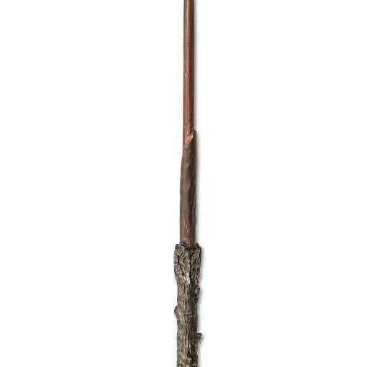
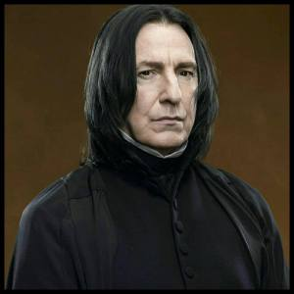
Business Questions
What are the major themes in the movie?
What spells were used and who performed them?
How do characters sentimentally change towards Snape along the movie?
What effect does music have?

Slide 3
Approach
Network Analysis
Text Analytics
Filter
Theme
Sentiment
Music
Gender

Slide 4
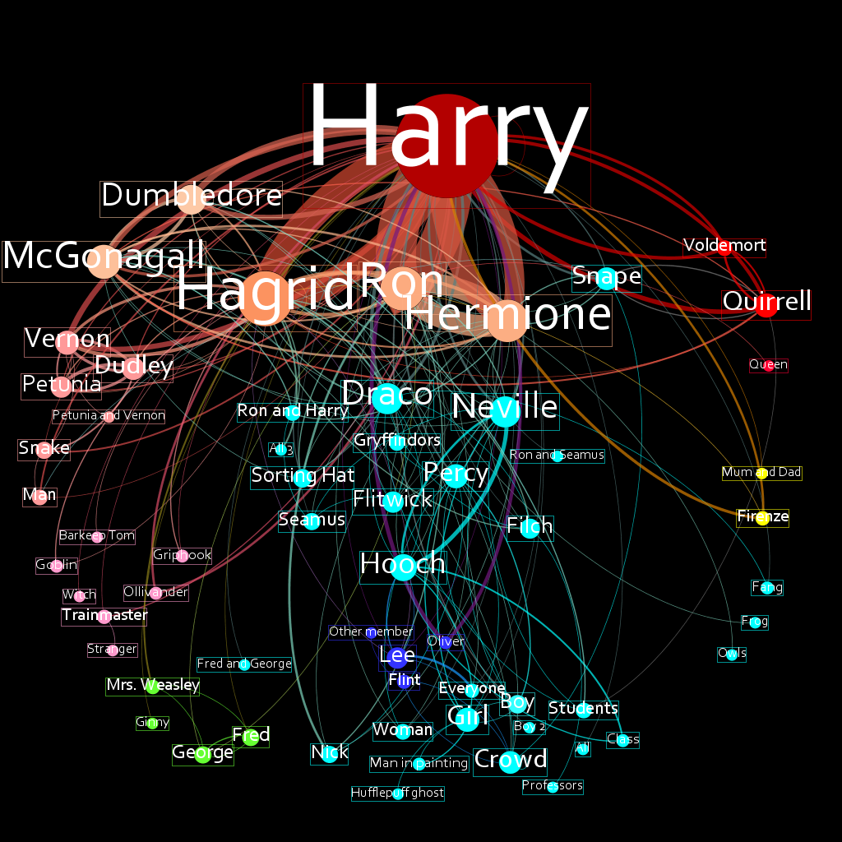
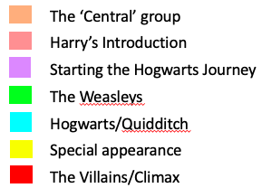
SNA
Analysis

Slide 5
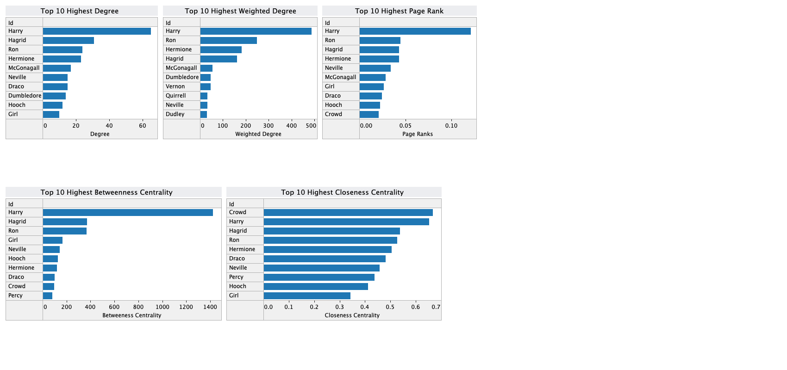
SNA – Metrics
Total Interactions = 1,680
Harry’s Total Interactions = 490
29.17%

Slide 6
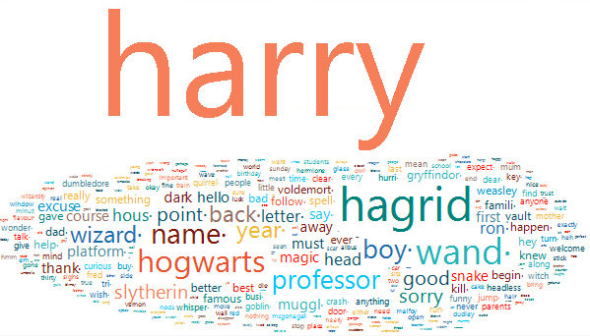
Part 1 – introduction
Main Character HARRY
874 terms
Harry Potter

Slide 7
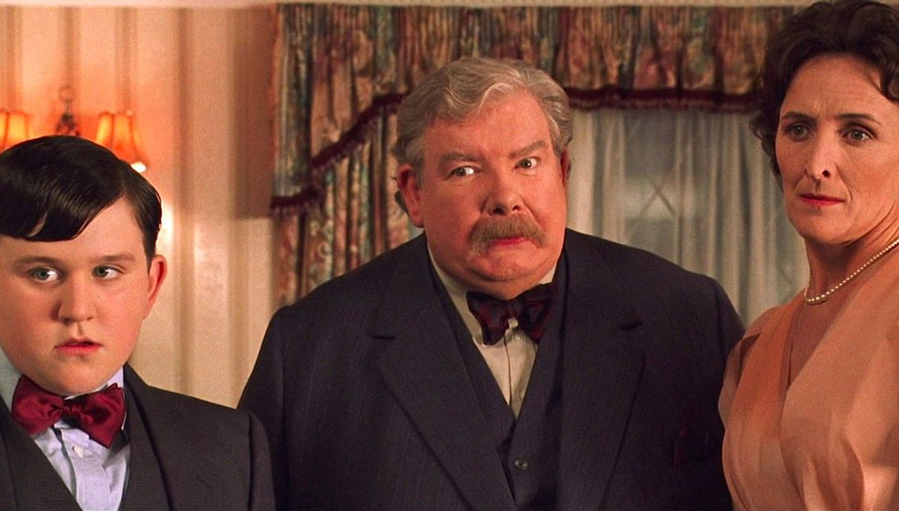
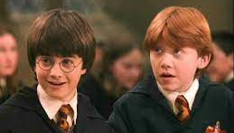
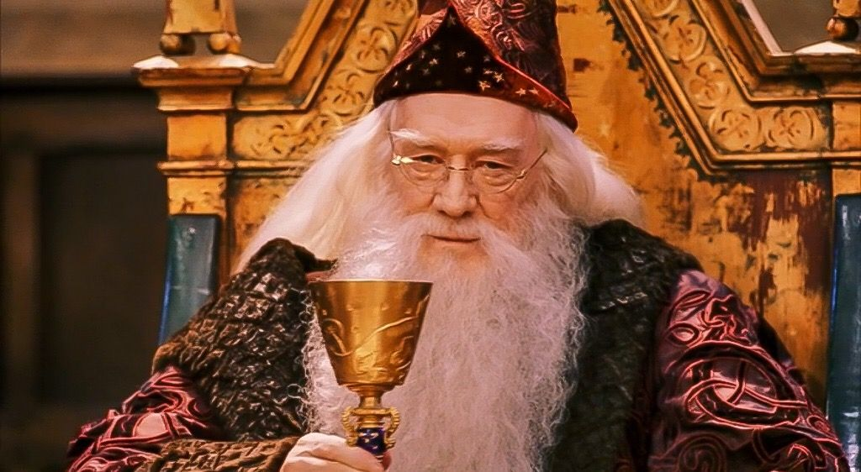
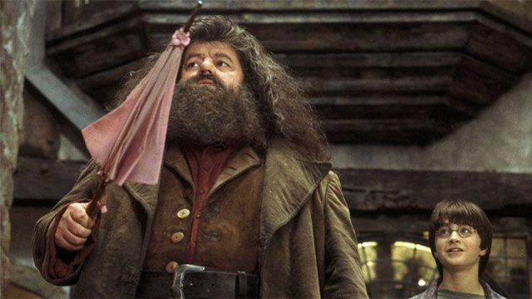
Part 1 – approach
Filter
Top 10 Conversations
Characters

Slide 8
Part 1 – thematic analysis
Cluster 1
Muggle Life
Cluster 2
Wizard Life
Cluster 3
Dark Magic
Cluster 1 | Cluster 2 | Cluster 3
harry | hagrid | mother
sorry | hogwarts | name
muggle | owl | voldemort
snake | wizard | kill
letter | boy | dad
dudley | hermione | car crash
birthday | dumbledore | dark
cake | ron | die
vernon | mcgonagall | famous
family | spell | magic

Slide 9
Part 1 – themes
Contrasting WORLDS
Good vs. evil

Slide 10
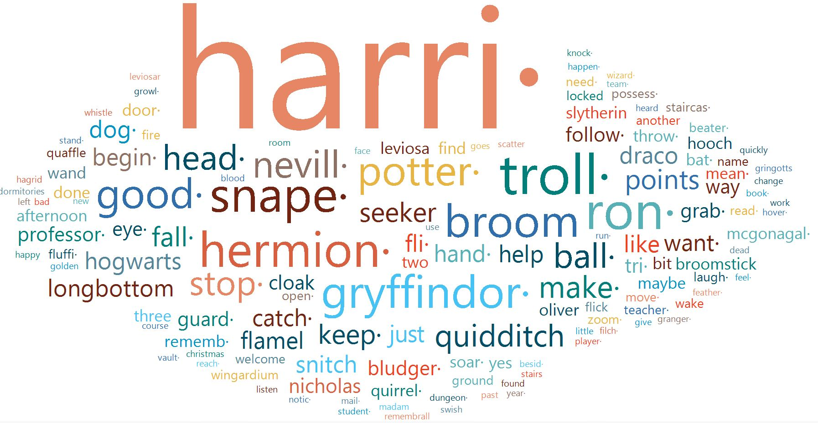
Part 2 – introduction
Main Character HARRY
941 terms
Harry Potter

Slide 11
Part 2 – thematic analysis
Cluster 1
Nicholas Flamel's connection to Fluffy
Cluster 2
Learning to fly broomstick
Cluster 3
The game of Quidditch
Cluster 1 | Cluster 2 | Cluster 3
troll | harry | harry
head | broom | seeker
ron | good | potter
stop | potter | points
dog | fly | grab
flamel | draco | fall
nicholas | hooch | snitch
remember | longbottom | bat
leviosa | make | catch
try | hermione | oliver

Slide 12






















Part 2 – themes
Quidditch
Sorcerer’s stone

Slide 13
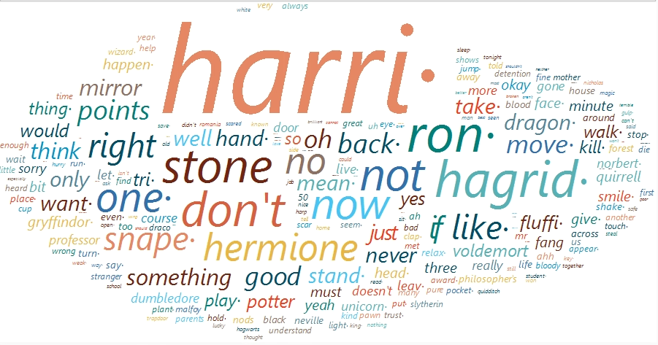
Part 3 – introduction
Main Character HARRY
931 terms
Harry Potter

Slide 14
Part 3 – thematic analysis
Cluster 1
The truth about Snape
Cluster 2
Voldermort’s reveal
Cluster 3
Friendship
Cluster 1 | Cluster 2 | Cluster 3
stone | harry | harry
know | mirror | hermione
snape | stone | hagrid
try to kill | voldemort | ron
professor | quirrell | play
sorry | hand | dragon
never | unicorn | fluffy
fluffy | stand | come
hand | never | first
ron | head | time

Slide 15
Part 3 – themes
Discovery
Friendship

Slide 16
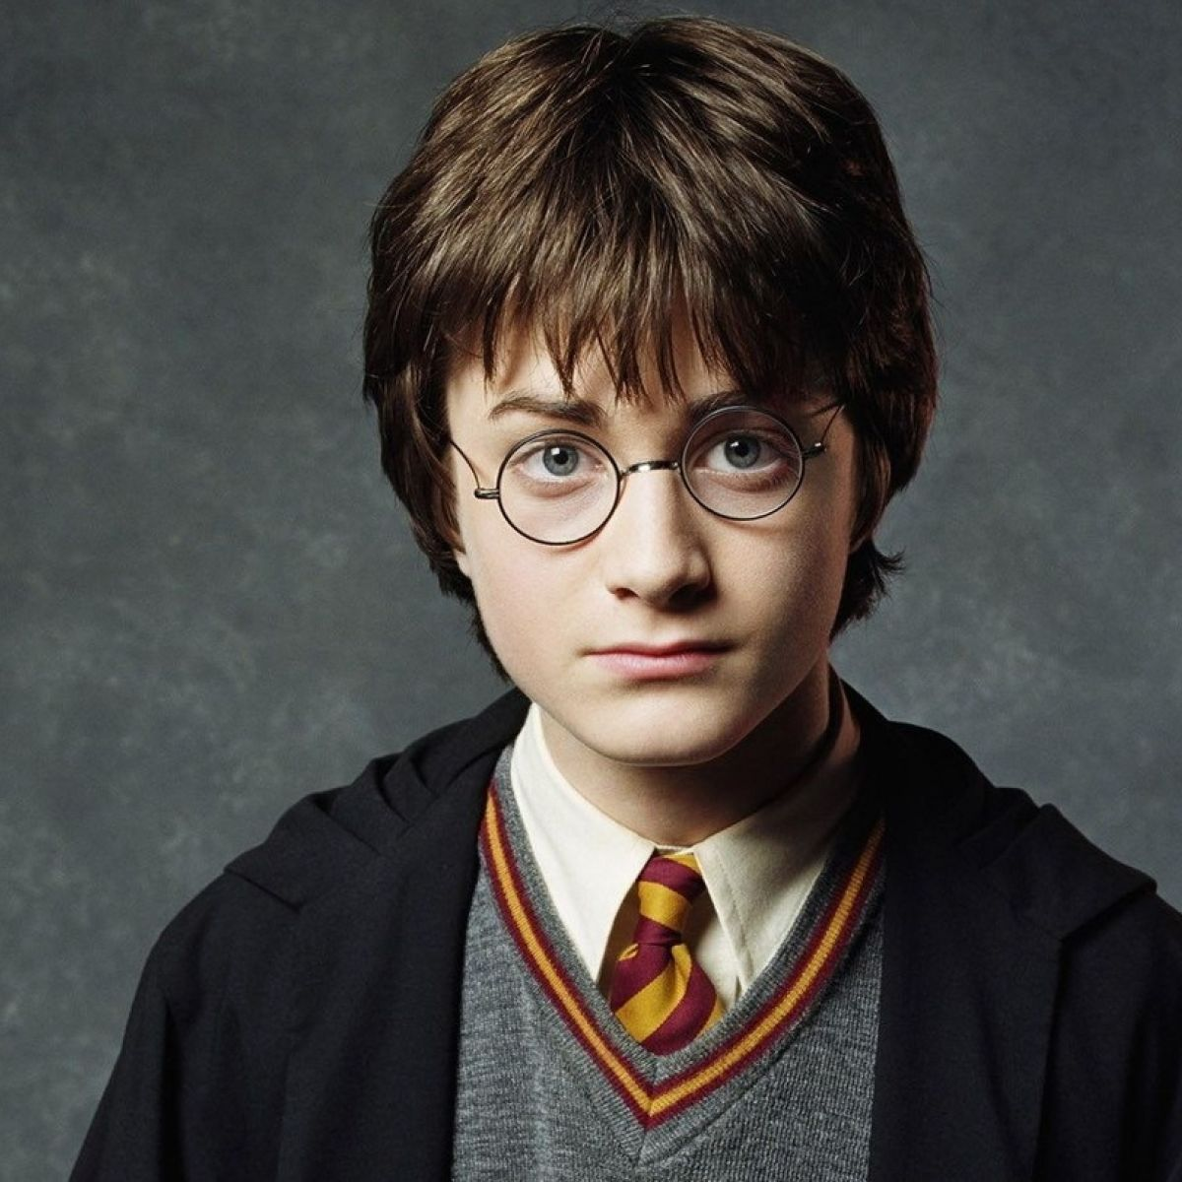

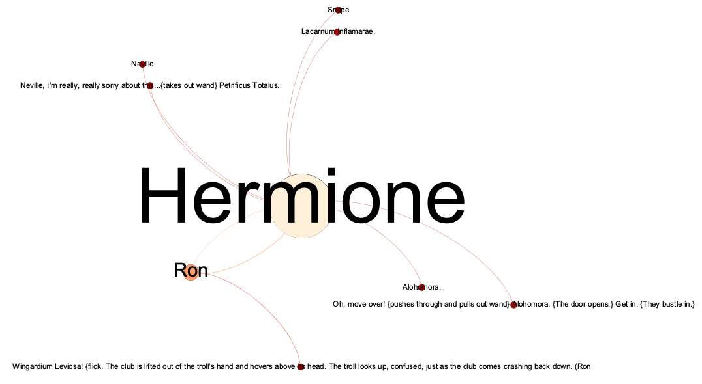
Spells – Network Analysis
Alohomora
Lacarnum Inflamarae
Petrificus Totalus
Wingardium Leviosa

Slide 17
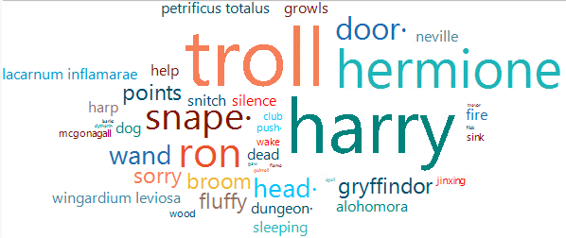
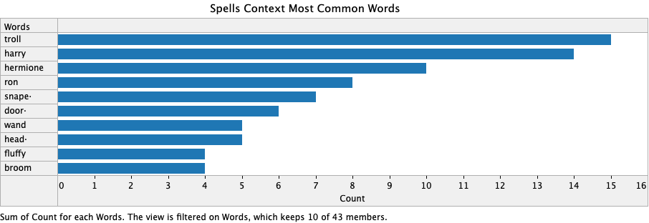
Spells Text Analysis
Total terms: 385
Total terms considered: 43

Slide 18
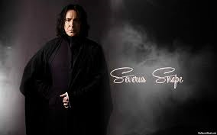
Foe or Friend?

Slide 19
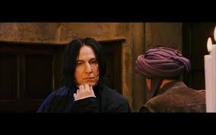
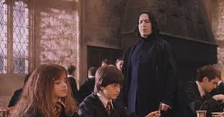
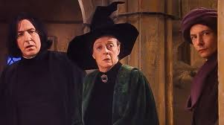
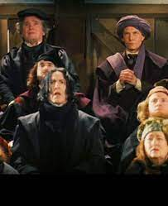
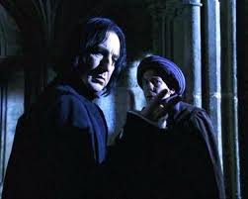
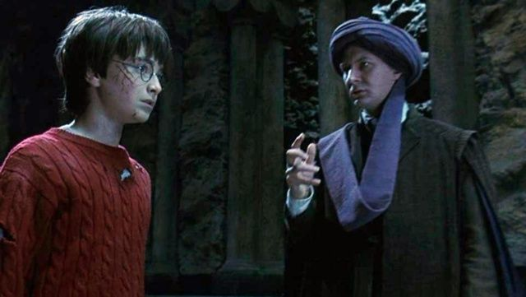
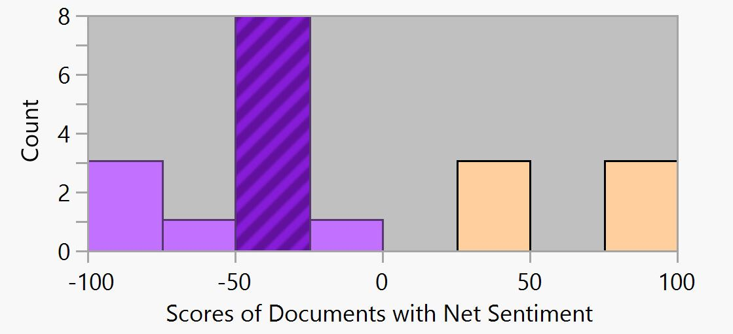
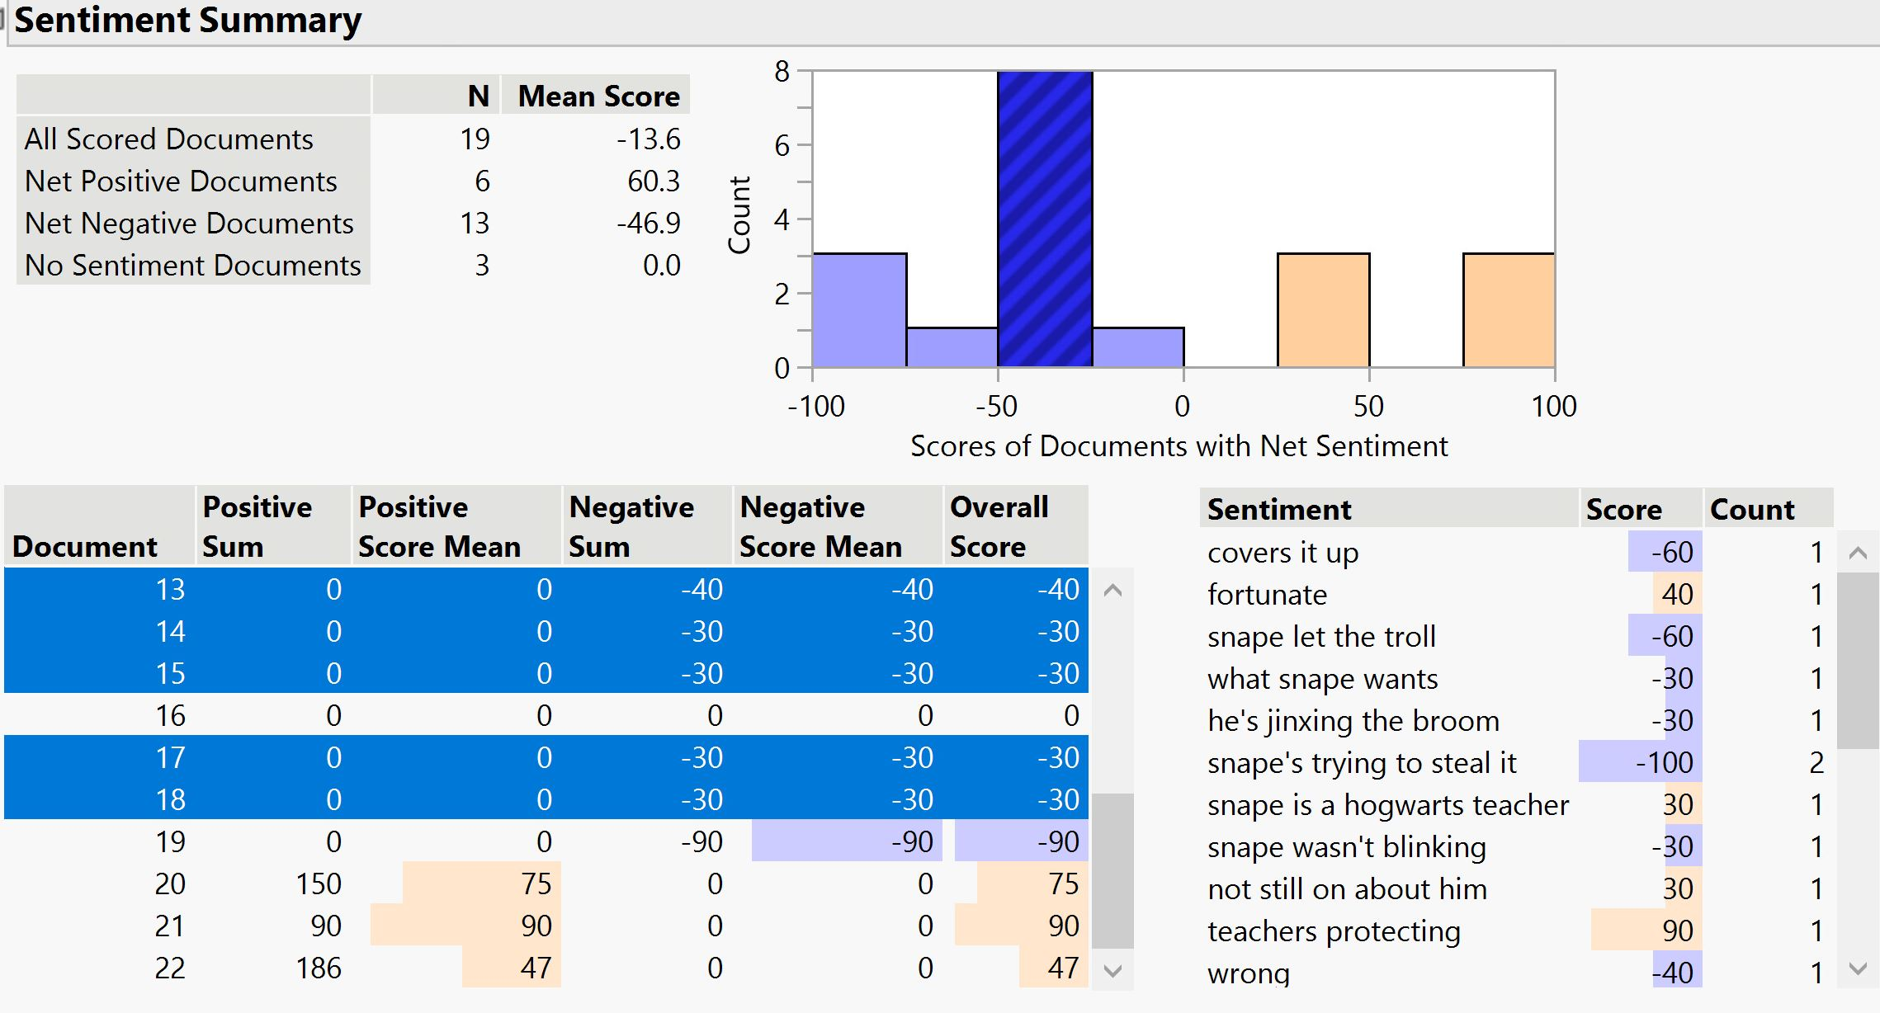
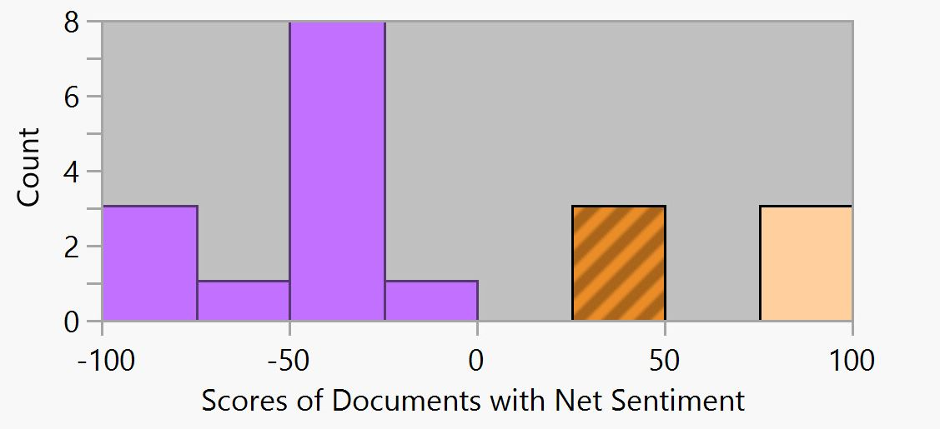
Snape – sentiment analysis (JMP)
Covers it up
Trying to steal it
Jinxing the broom
Hogwarts teacher
Never trusted me
Trying to Save Me?

Slide 20
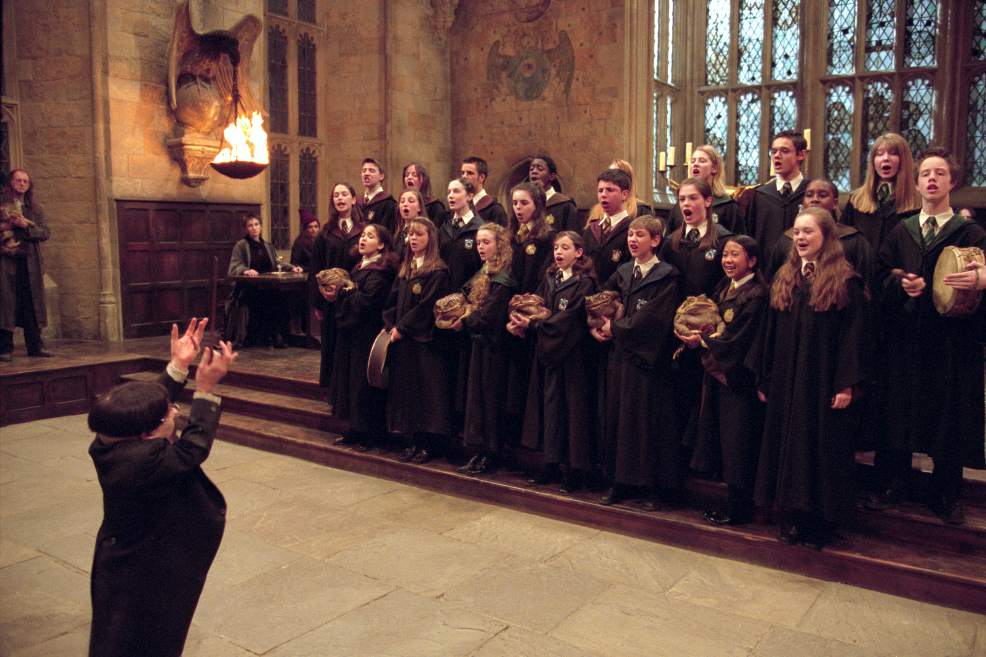

Music Analytics

Slide 21
Themes
Happy + Exciting
Prologue | Theme/Intro
The Arrival of Baby Harry | Mystery
Visit to the Zoo and Letters from Hogwarts | Happy
Diagon Alley and the Gringotts Vault | Happy
Platform Nine-and-Three-Quarters and the Journey to Hogwarts | Exciting
Entry into the Great Hall and the Banquet | Welcoming/Exciting
Contrasting worlds
Good vs Evil
PART 1
Spirited + Mysterious
Mr. Longbottom Flies | Panic
Hogwarts Forever! And the Moving Stairs | Proud
The Norwegian Ridgeback and a Change of Season | Peaceful
The Quidditch Match | Motivational/Spirited/Triumphant
Christmas at Hogwarts | Happy
The invisibility Cloak and the Library Scene | Mysterious
Quidditch
Sorcer’s Stone
PART 2
Tense + Joyous
Fluffy’s Harp | Peaceful
In the Devil’s Snare and the Flying Keys | Chaotic
The Chess Game | Tense
The Face of Voldemort | Tense
Leaving Hogwarts | Heartwarming
Harry’s Wondrous World | Joyous
Discovery
Friendship
PART 3

Slide 22
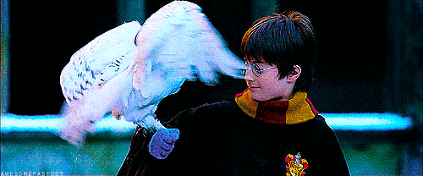
Music-to-magic pattern
Hedwig’s theme

Slide 23
Gender Analysis
Male | Female
Dumbledore | McGonagall
Hagrid | Petunia
Dudley | Hermione
Harry | Mrs. Weasley
Ron | Woman
Vernom | Ginny
Quirrell | Girl
George | Hooch
Fred
Seamus
Neville
Snape
Draco
Flich
Voldemort
Lee
Percy
Boy
Total Characters: 26
Total Male Characters: 18
Total Female Characters: 8
Males 69%

Slide 24
Insights characters
Harry and other major characters

Slide 25
Insights – themes
Contrasting Worlds
Good vs. Evil
Quidditch
Sorcerer’s Stone
Discovery
Friendship

Slide 26
Insights – other
Harry was being protected by others → NO use of spells
Key sentimental change towards Snape
Music has a great impact on movie sentiments
69% of the characters being males

Slide 27

Questions?

Slide 28
References
Columbus, Chris, director. Harry Potter and the Sorcerer's Stone. 2001.
“Harry Potter and the Philosopher's Stone (Film).” Wikipedia, Wikimedia Foundation, 30 May 2021, en.wikipedia.org/wiki/Harry_Potter_and_the_Philosopher%27s_Stone_(film).
Images from https://www.google.com/
https://www.youtube.com/watch?v=UuPb1J_RCJM&list=PLsYgm6hOXgDToCj9jZ80rUUXVH93EDyHM

